Slide 1

Customer Churn Prediction: Model Development and Evaluation

Slide 2
Introduction
Objective: Predict customer churn using various features from a banking dataset to improve retention strategies.
Dataset Overview: Includes customer profiles and banking behavior attributes.

Slide 3
Dataset Overview
Fields in the Dataset:
CustomerId: Unique identifier for each customer
Surname: Customers last name
CreditScore: Numerical value representing the customers credit score
Geography: Country where the customer resides (France, Spain, Germany)
Gender: Customers gender (Male, Female)
Age: Customers age
Tenure: Number of years the customer has been with the bank
Balance: Customers account balance
NumOfProducts: Number of bank products the customer uses
HasCrCard: Whether the customer has a credit card (1 = yes, 0 = no)
IsActiveMember: Whether the customer is an active member (1 = yes, 0 = no)
EstimatedSalary: Estimated salary of the customer
Exited: Whether the customer has churned (1 = yes, 0 = no)
Fields Rejected:
CustomerId
Surname (Reason: Qualitative data with no predictive value)

Slide 4
Exploratory Data Analysis (EDA)
Key steps in EDA:
Analyzed the distribution of continuous variables (e.g., Age, Balance).
Checked for missing values and outliers.
Identified categorical variables and their distribution.

Slide 5
Statistical Tests and Feature Selection
Performed the following statistical tests:
ANOVA: Used to identify significant continuous variables.
ChiSquare Test: Used to assess the relationship between categorical variables and the target.
Selected final features: NumOfProducts, IsActiveMember, Age, Balance.

Slide 6
Model Development
Train-Test Split: 70% training, 30% testing.
Models Evaluated:
Logistic Regression
Decision Tree Classifier
Random Forest Classifier

Slide 7
Logistic Regression Results
The Logistic Regression model was developed to establish a baseline for predicting customer churn.
Key Metrics:
Accuracy: 77%
Precision: 0.83 (Class 0), 0.61 (Class 1)
Recall: 0.97 (Class 0), 0.21 (Class 1)
F1Score: 0.89 (Class 0), 0.32 (Class 1)

Slide 8
Decision Tree Results
The Decision Tree model was developed to provide more interpretability and feature importance analysis.
Key Metrics:
Accuracy: 79%
Precision: 0.83 (Class 0), 0.86 (Class 1)
Recall: 0.99 (Class 0), 0.24 (Class 1)
F1Score: 0.90 (Class 0), 0.37 (Class 1)

Slide 9
Random Forest Results
The Random Forest model was developed to leverage ensemble learning and improve prediction accuracy.
Key Metrics:
Accuracy: 82%
Precision: 0.85 (Class 0), 0.73 (Class 1)
Recall: 0.86 (Class 0), 0.69 (Class 1)
F1Score: 0.85 (Class 0), 0.71 (Class 1)

Slide 10
Model Implementation
Final Feature Set: NumOfProducts, IsActiveMember, Age, Balance

Slide 11
Faulty Row Identification
Faulty rows were identified based on misclassifications from the initial Random Forest model. These rows were removed to clean the dataset, improving model performance.

Slide 12
Final Model Training
The Random Forest model was retrained on the cleaned dataset (after removing faulty rows). This model was then evaluated on the test set to ensure its robustness and accuracy.

Slide 13
Model Evaluation
The final Random Forest model's performance was evaluated using the following metrics:
Accuracy
Confusion Matrix
ROC AUC Score
Classification Report

Slide 14
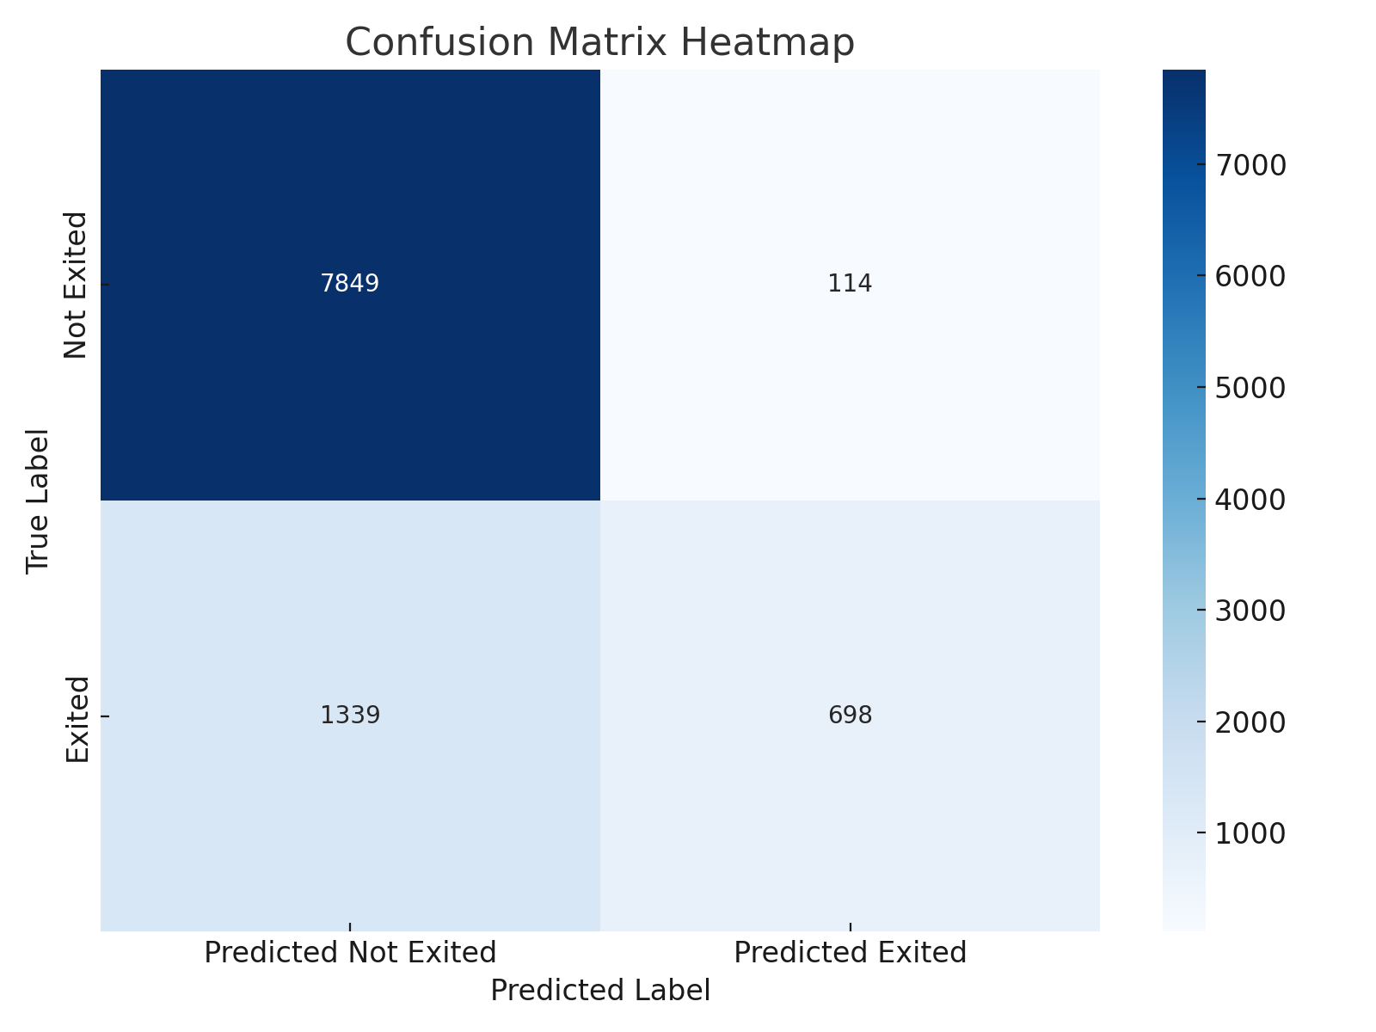
Confusion Matrix Visualization

Slide 15
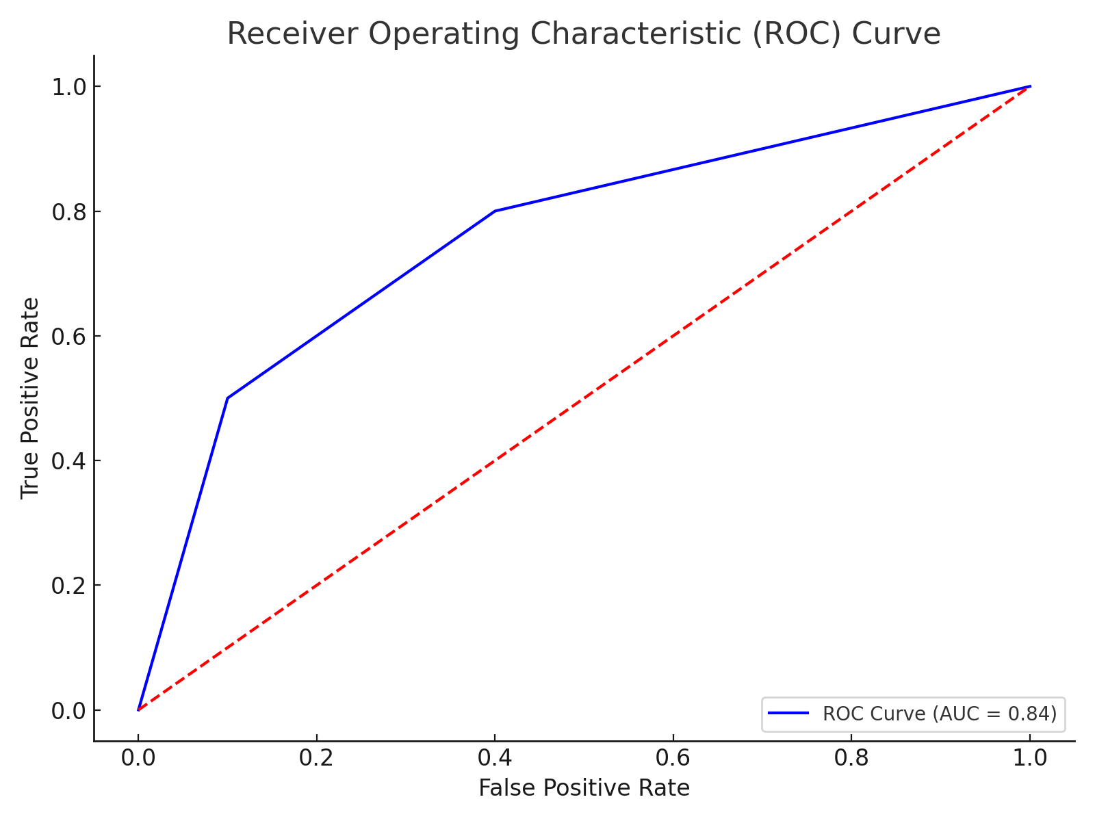
ROC Curve Visualization

Slide 16
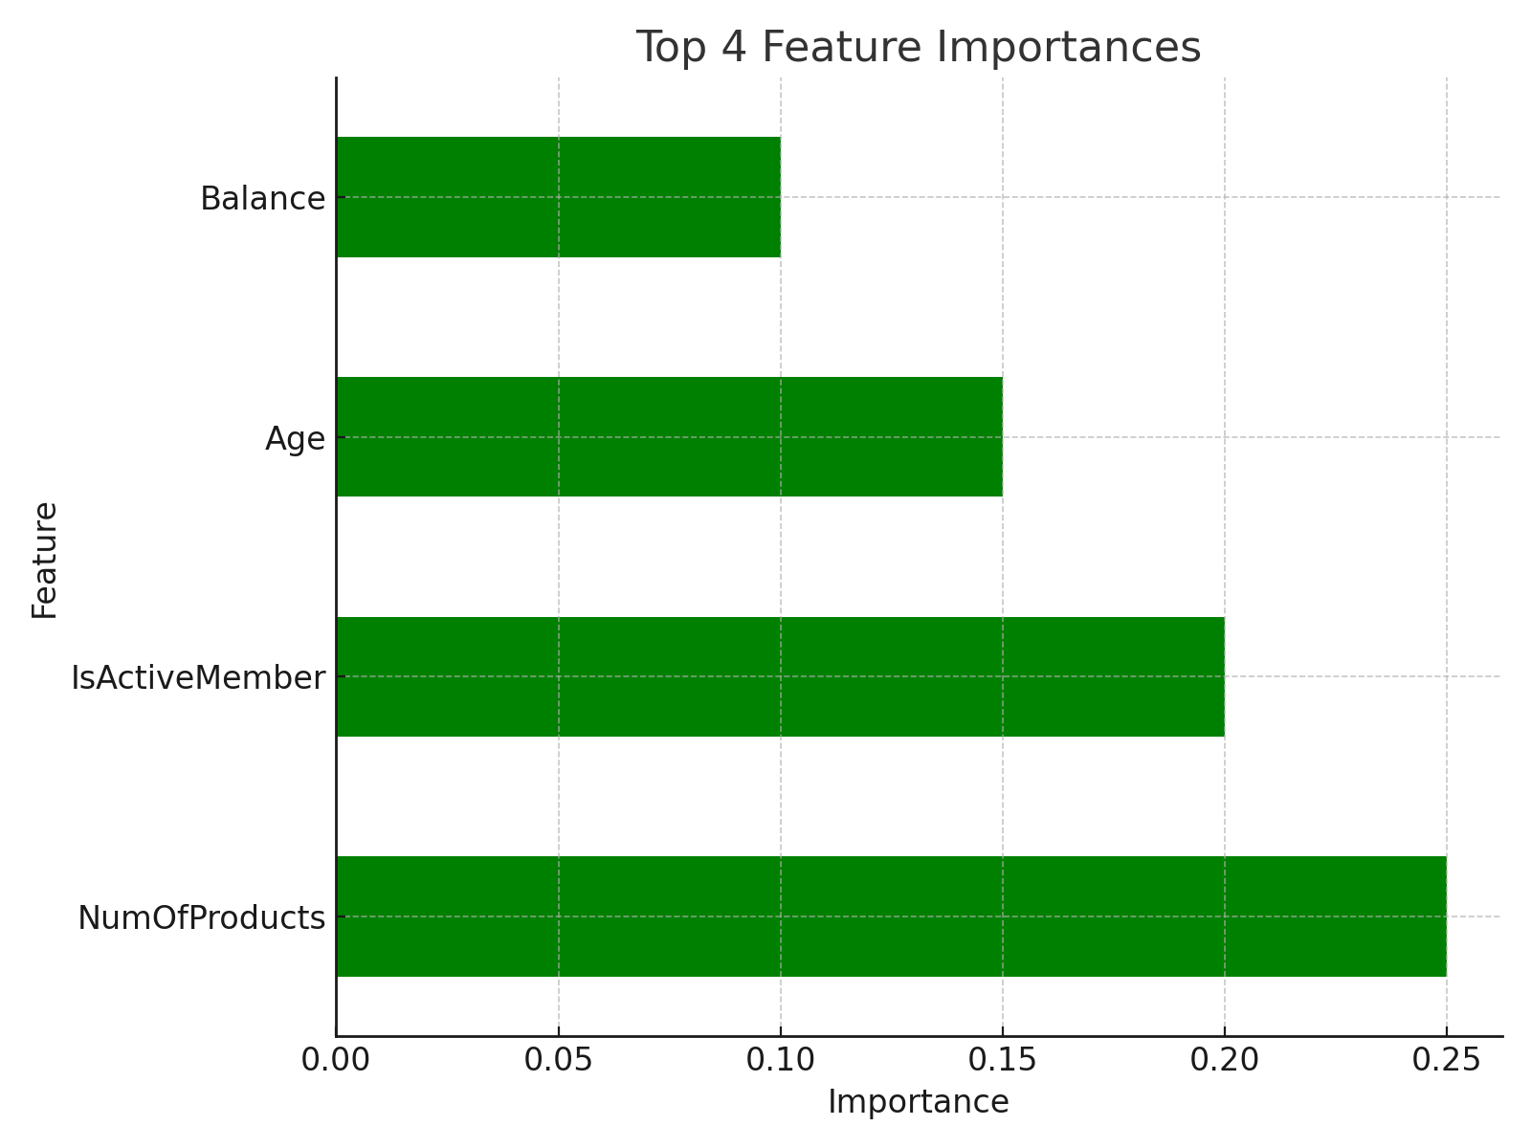
Feature Importance Visualization

Slide 17
Conclusion
The Random Forest model, after removing faulty rows, demonstrated improved accuracy and robustness. The model evaluation metrics indicate that the model is well suited for predicting customer churn. The final model has been saved for future deployment and use.

